Slide 1
Advanced Topic 2: Double/debiased Machine Learning with Regression Calibration
ENAR 2026
Indianapolis, IN
Molin Wang
mwang@hsph.Harvard.edu
Departments of Epidemiology and Biostatistics
Harvard T. H. Chan School of Public Health
Channing Division of Network Medicine
Brigham & Women’s Hospital and Harvard Medical School
Work by Gang Xu, Xin Zhou, Molin Wang, Boya Zhang, Wenhao Jiang, Francine Laden, Helen Shuh, Adam Szpiro, Donna Spiegelman, Zhuoheng Wang*

Slide 2
Background
Environmental Epidemiology
Assess the impact of air pollution on human health
Multiple chemical constituents in PM_{2.5}
Estimate the effects of individual PM_{2.5} constituents
Challenges
PM_{2.5} constituents are correlated, confound one another, and of high dimension
Exposure measurement error can lead to bias in environmental epidemiological studies
Research Question
Estimate the effects of correlated multi-pollutant constituents on a health outcome when exposures are measured with error

Slide 3
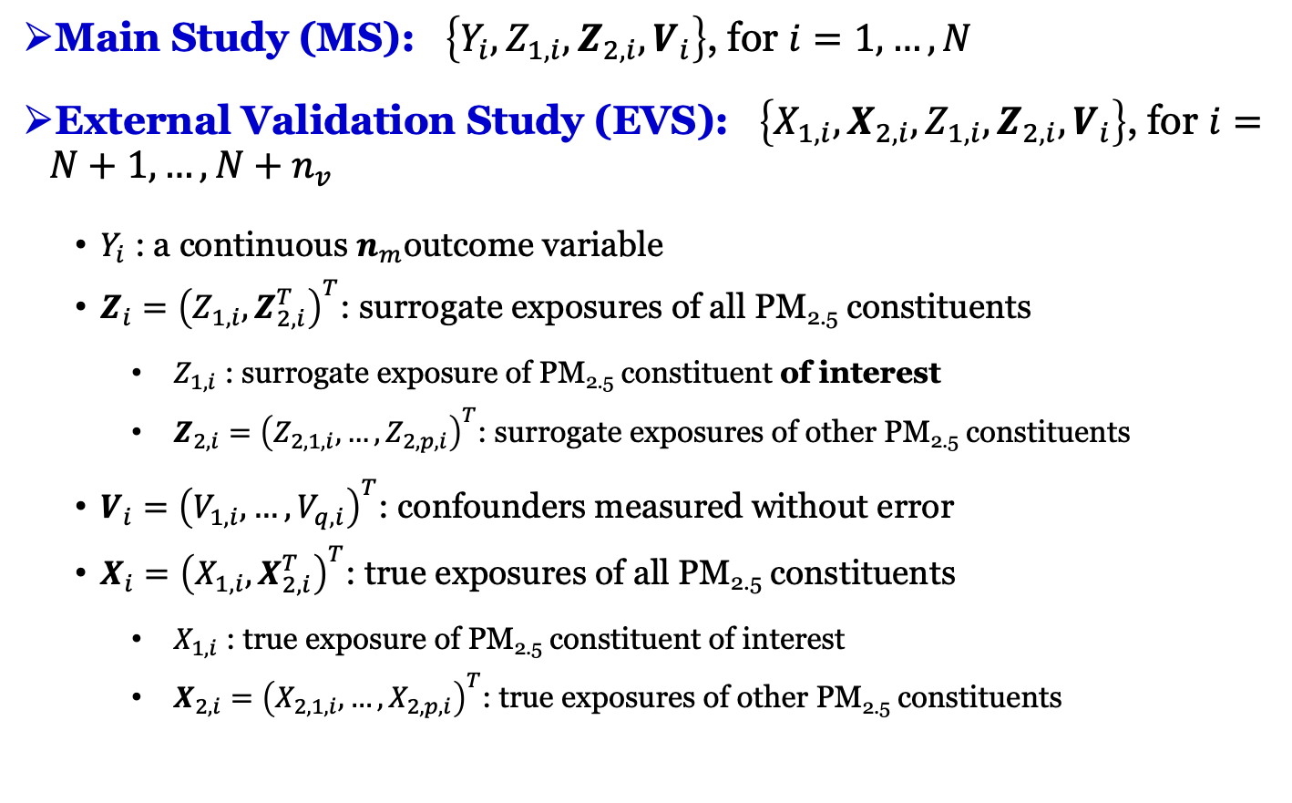
Study design and notations
Main Study (MS): $\left\{Y_{i},Z_{1,i},Z_{2,i},V_{i}\right\}$, for $i=1,…,N$
External Validation Study (EVS): $\left\{X_{1,i},X_{2,i},Z_{1,i},Z_{2,i},V_{i}\right\}$, for $i=N+1,…,N+$ $n_{v}$
$Y_{i}$ : a continuous $n_{m}$outcome variable
$Z_{i}={\left(Z_{1,i},Z_{2,i}^{T}\right)}^{T}$: surrogate exposures of all PM_{2.5} constituents
$Z_{1,i}$ : surrogate exposure of PM_{2.5} constituent of interest
$Z_{2,i}={\left(Z_{2,1,i},…,Z_{2,p,i}\right)}^{T}$: surrogate exposures of other PM_{2.5} constituents
$V_{i}={\left(V_{1,i},…,V_{q,i}\right)}^{T}$: confounders measured without error
$X_{i}={\left(X_{1,i},X_{2,i}^{T}\right)}^{T}$: true exposures of all PM_{2.5} constituents
$X_{1,i}$ : true exposure of PM_{2.5} constituent of interest
$X_{2,i}={\left(X_{2,1,i},…,X_{2,p,i}\right)}^{T}$: true exposures of other PM_{2.5} constituents

Slide 4
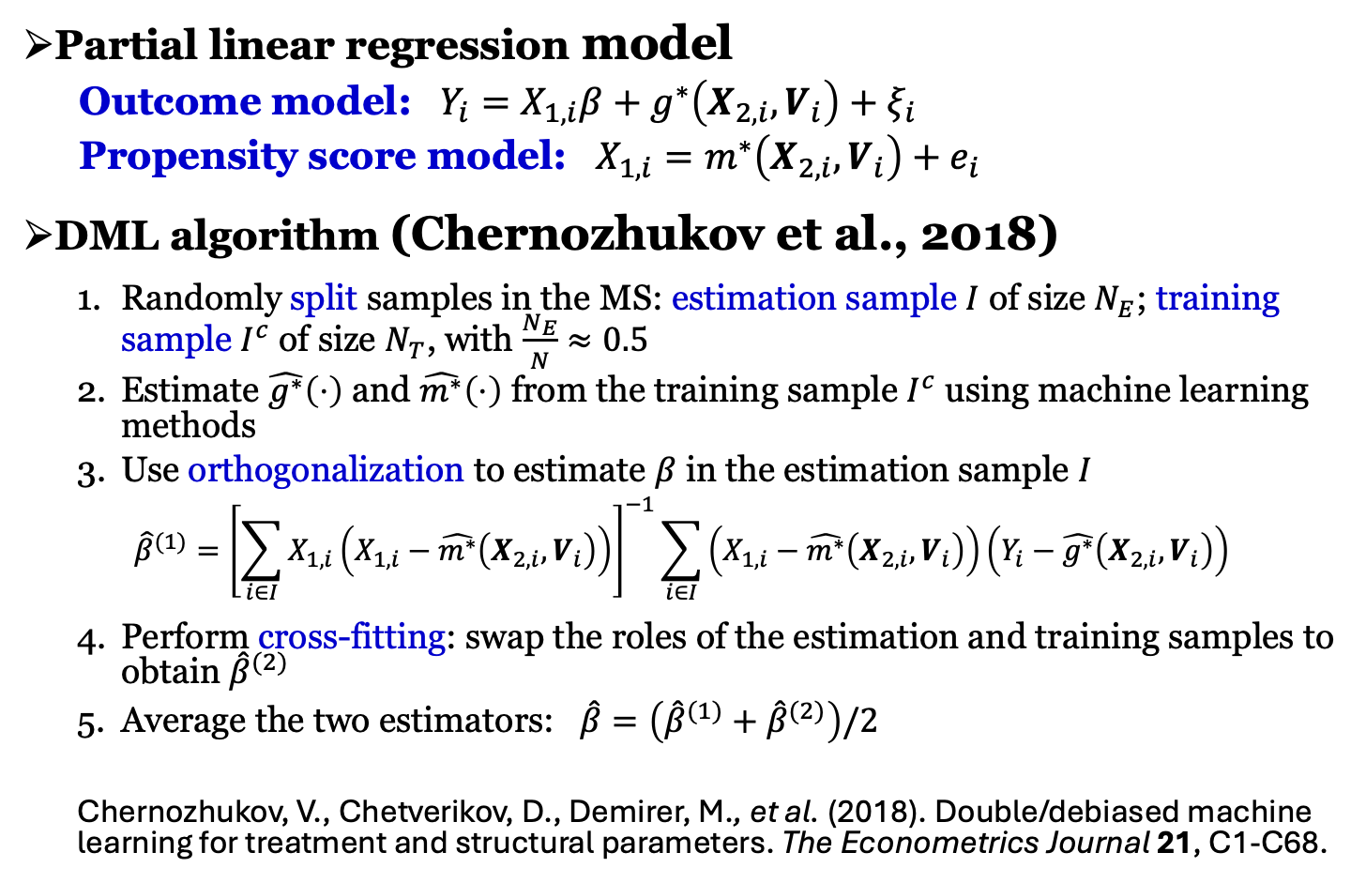
Double/debiased machine learning (DML)
Partial linear regression model
Outcome model: $Y_{i}=X_{1,i}β+g^{∗}\left(X_{2,i},V_{i}\right)+ξ_{i}$
Propensity score model: $X_{1,i}=m^{∗}\left(X_{2,i},V_{i}\right)+e_{i}$
DML algorithm (Chernozhukov et al., 2018)
Randomly split samples in the MS: estimation sample $I$ of size $N_{E}$; training sample $I^{c}$ of size $N_{T}$, with $\frac{N_{E}}{N}≈0.5$
Estimate $\hat{g^{∗}}\left(⋅\right)$ and $\hat{m^{∗}}\left(⋅\right)$ from the training sample $I^{c}$ using machine learning methods
Use orthogonalization to estimate $β$ in the estimation sample $I$
$${\hat{β}}^{(1)}={\left[\sum_{i∈I}{X_{1,i}\left(X_{1,i}−\hat{m^{∗}}\left(X_{2,i},V_{i}\right)\right)}\right]}^{−1}\sum_{i∈I}{\left(X_{1,i}−\hat{m^{∗}}\left(X_{2,i},V_{i}\right)\right)\left(Y_{i}−\hat{g^{∗}}\left(X_{2,i},V_{i}\right)\right)}$$
Perform cross-fitting: swap the roles of the estimation and training samples to obtain ${\hat{β}}^{(2)}$
Average the two estimators: $\hat{β}=\left({\hat{β}}^{(1)}+{\hat{β}}^{(2)}\right)/2$
Chernozhukov, V., Chetverikov, D., Demirer, M., et al. (2018). Double/debiased machine learning for treatment and structural parameters. The Econometrics Journal 21, C1-C68.

Slide 5
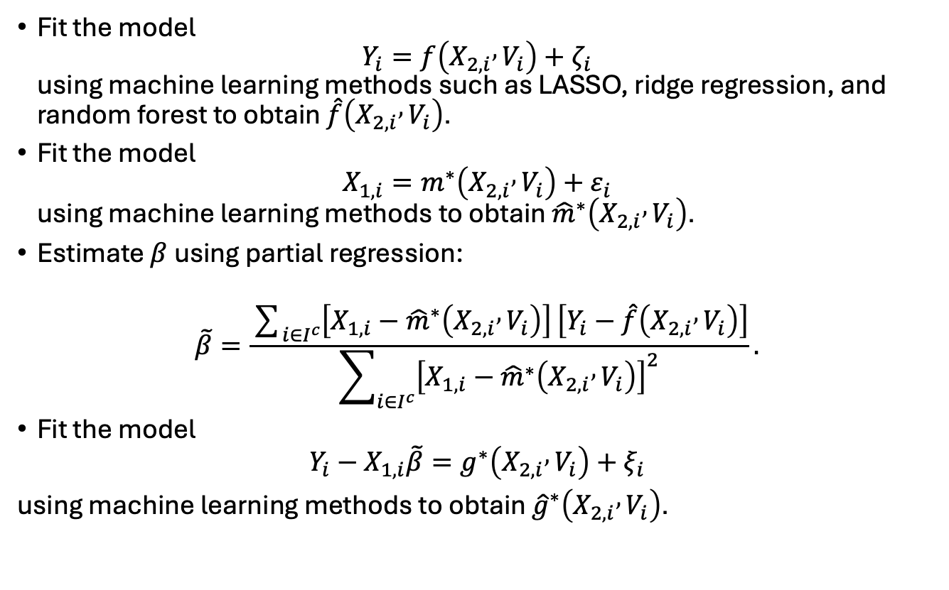
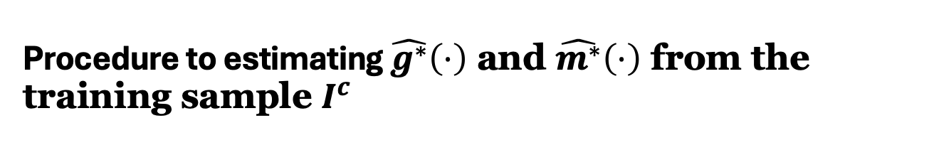
Procedure to estimating $\hat{g^{∗}}\left(⋅\right)$ and $\hat{m^{∗}}\left(⋅\right)$ from the training sample $I^{c}$
Fit the model $Y_{i}=f\left(X_{2,i} , V_{i}\right)+ζ_{i}$ using machine learning methods such as LASSO, ridge regression, and random forest to obtain $\hat{f}\left(X_{2,i} , V_{i}\right)$.
Fit the model $X_{1,i}=m^{∗}\left(X_{2,i} , V_{i}\right)+ε_{i}$ using machine learning methods to obtain ${\hat{m}}^{∗}\left(X_{2,i} , V_{i}\right)$.
Estimate $β$ using partial regression:
$$\tilde{β}=\frac{\sum_{i∈I^{c}}{\left[X_{1,i}−{\hat{m}}^{∗}\left(X_{2,i} , V_{i}\right)\right]}\left[Y_{i}−\hat{f}\left(X_{2,i} , V_{i}\right)\right]}{\sum_{i∈I^{c}}{{\left[X_{1,i}−{\hat{m}}^{∗}\left(X_{2,i} , V_{i}\right)\right]}^{2}}}.$$
Fit the model
$$Y_{i}−X_{1,i}\tilde{β}=g^{∗}\left(X_{2,i} , V_{i}\right)+ξ_{i}$$
using machine learning methods to obtain ${\hat{g}}^{∗}\left(X_{2,i} , V_{i}\right)$.

Slide 6
Double/debiased machine learning (DML)
Statistical properties
Orthogonalization: correct for bias on low-dimensional parameter of interest due to regularization on high-dimensional nuisance parameters
Sample splitting: reduce bias due to overfitting
Cross-fitting: gain estimation efficiency

Slide 7
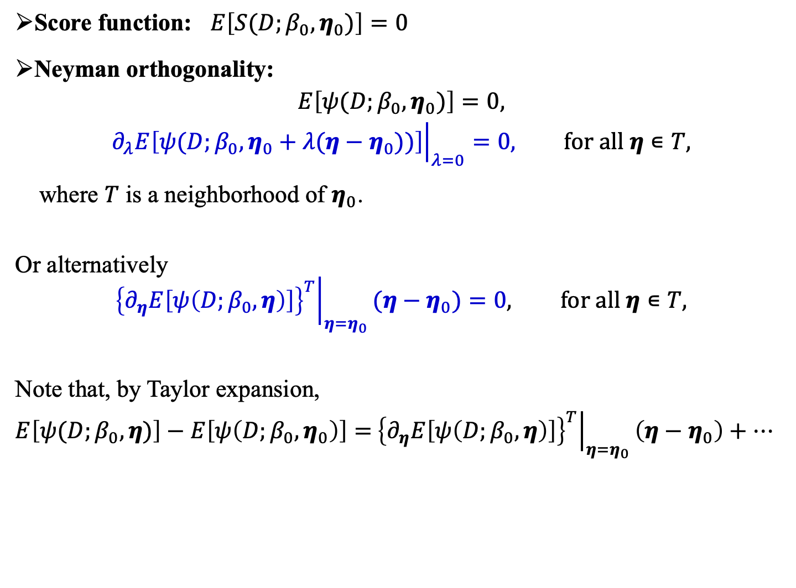
Neyman orthogonality
Score function: $E\left[S(D;β_{0},η_{0})\right]=0$
Neyman orthogonality:
$$E\left[ψ(D;β_{0},η_{0})\right]=0,$$
$${\left.∂_{λ}E\left[ψ(D;β_{0},η_{0}+λ(η−η_{0}))\right]\right|}_{λ=0}=0, for all η∊T,$$
where $T$ is a neighborhood of $η_{0}$.
Or alternatively
$${\left.{\left\{∂_{η}E\left[ψ\left(D;β_{0},η\right)\right]\right\}}^{T}\right|}_{η=η_{0}}(η−η_{0})=0, for all η∊T,$$
Note that, by Taylor expansion,
$E\left[ψ(D;β_{0},η)\right]−E\left[ψ\left(D;β_{0},η_{0}\right)\right]=$ ${\left.{\left\{∂_{η}E\left[ψ\left(D;β_{0},η\right)\right]\right\}}^{T}\right|}_{η=η_{0}}\left(η−η_{0}\right)+…$
Notes:
In sensitive to bias in the eta estiamtes; if expance psi by Taylor expansion at beta0 and eta0, this says that the leading term for eta-eta_0 is zero, so as long as eta.hat is good enough, beta.hat can still be sqrt(n) consister…

Slide 8
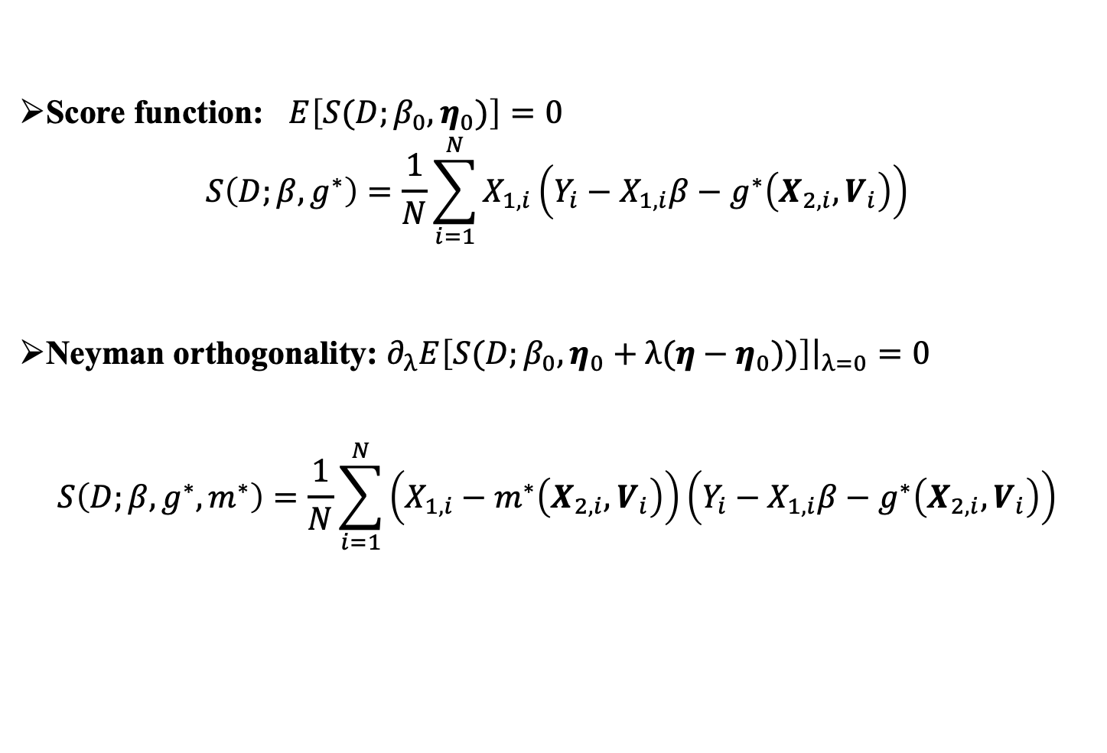
Double/debiased machine learning (DML)
Score function: $E\left[S(D;β_{0},η_{0})\right]=0$
$$S\left(D;β,g^{∗}\right)=\frac{1}{N}\sum_{i=1}^{N}{X_{1,i}\left(Y_{i}−X_{1,i}β−g^{∗}\left(X_{2,i},V_{i}\right)\right)}$$
Neyman orthogonality: ${\left.∂_{λ}E\left[S(D;β_{0},η_{0}+λ(η−η_{0}))\right]\right|}_{λ=0}=0$
$$S\left(D;β,g^{∗},m^{∗}\right)=\frac{1}{N}\sum_{i=1}^{N}{\left(X_{1,i}−m^{∗}\left(X_{2,i},V_{i}\right)\right)\left(Y_{i}−X_{1,i}β−g^{∗}\left(X_{2,i},V_{i}\right)\right)}$$

Slide 9
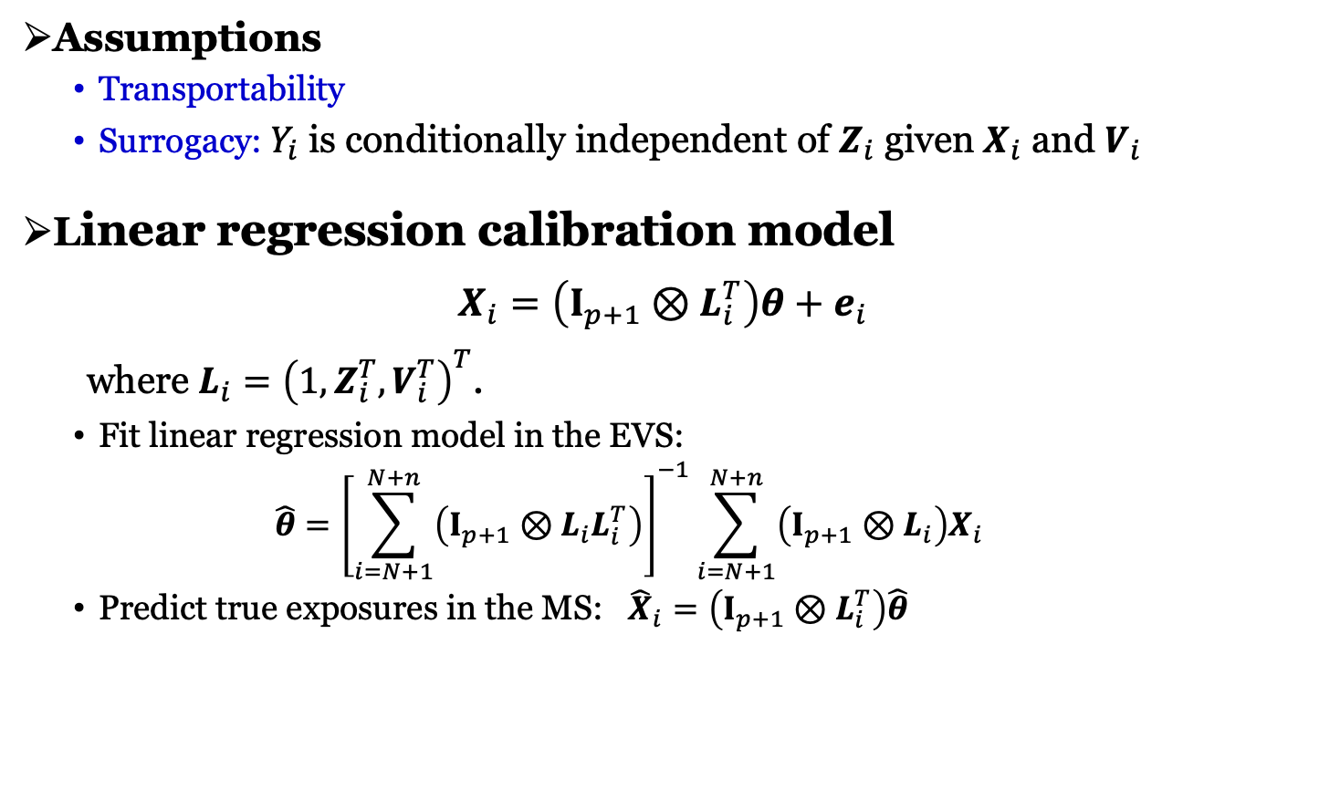
Measurement error correction
Assumptions
Transportability
Surrogacy: $Y_{i}$ is conditionally independent of $Z_{i}$ given $X_{i}$ and $V_{i}$
Linear regression calibration model
$$X_{i}=\left(I_{p+1}⊗L_{i}^{T}\right)θ+e_{i}$$
where $L_{i}={\left(1,Z_{i}^{T},V_{i}^{T}\right)}^{T}$.
Fit linear regression model in the EVS:
$$\hat{θ}={\left[\sum_{i=N+1}^{N+n}{\left(I_{p+1}⊗L_{i}L_{i}^{T}\right)}\right]}^{−1}\sum_{i=N+1}^{N+n}{\left(I_{p+1}⊗L_{i}\right)X_{i}}$$
Predict true exposures in the MS: ${\hat{X}}_{i}=\left(I_{p+1}⊗L_{i}^{T}\right)\hat{θ}$
Notes:
$$⊗is kronecier product$$

Slide 10
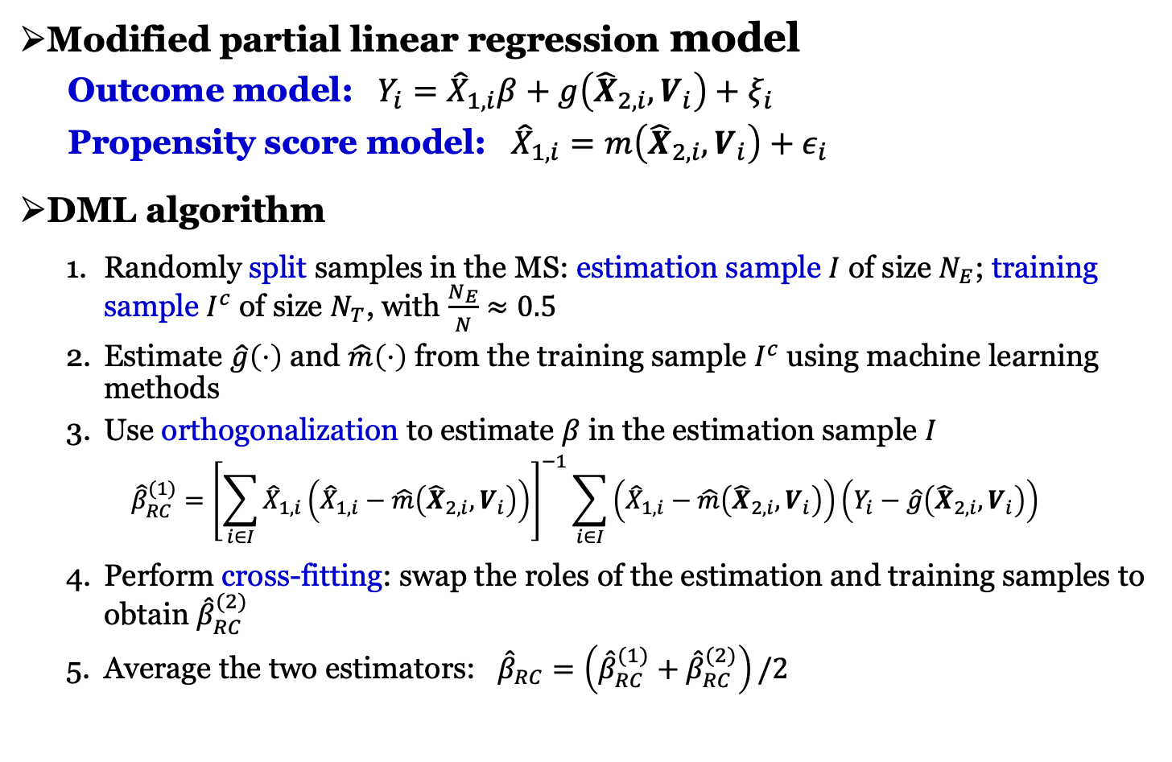
DML-RC
Modified partial linear regression model
Outcome model: $Y_{i}={\hat{X}}_{1,i}β+g\left({\hat{X}}_{2,i},V_{i}\right)+ξ_{i}$
Propensity score model: ${\hat{X}}_{1,i}=m\left({\hat{X}}_{2,i},V_{i}\right)+ε_{i}$
DML algorithm
Randomly split samples in the MS: estimation sample $I$ of size $N_{E}$; training sample $I^{c}$ of size $N_{T}$, with $\frac{N_{E}}{N}≈0.5$
Estimate $\hat{g}\left(⋅\right)$ and $\hat{m}\left(⋅\right)$ from the training sample $I^{c}$ using machine learning methods
Use orthogonalization to estimate $β$ in the estimation sample $I$
$${\hat{β}}_{RC}^{(1)}={\left[\sum_{i∈I}{{\hat{X}}_{1,i}\left({\hat{X}}_{1,i}−\hat{m}\left({\hat{X}}_{2,i},V_{i}\right)\right)}\right]}^{−1}\sum_{i∈I}{\left({\hat{X}}_{1,i}−\hat{m}\left({\hat{X}}_{2,i},V_{i}\right)\right)\left(Y_{i}−\hat{g}\left({\hat{X}}_{2,i},V_{i}\right)\right)}$$
Perform cross-fitting: swap the roles of the estimation and training samples to obtain ${\hat{β}}_{RC}^{(2)}$
Average the two estimators: ${\hat{β}}_{RC}=\left({\hat{β}}_{RC}^{(1)}+{\hat{β}}_{RC}^{(2)}\right)/2$

Slide 11
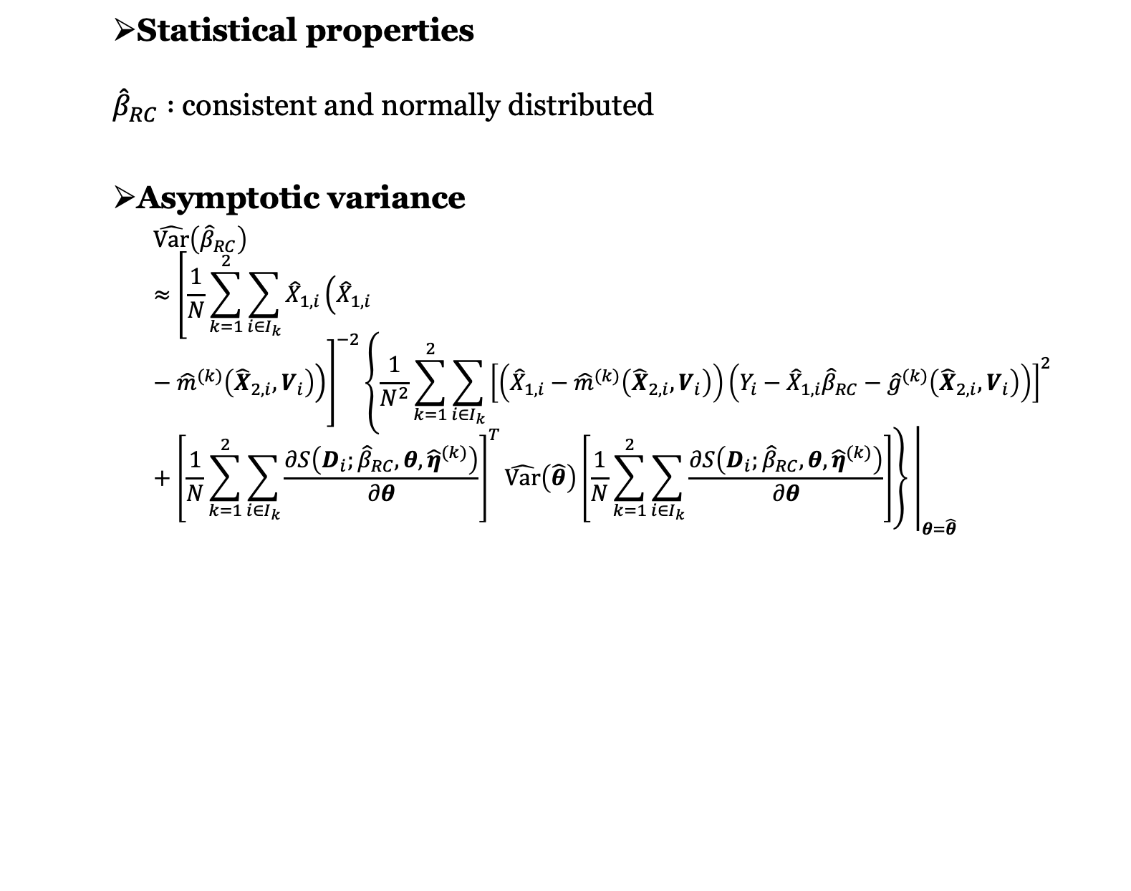
DML-RC
Statistical properties
${\hat{β}}_{RC} :$consistent and normally distributed
Asymptotic variance
$$\hat{Var}\left({\hat{β}}_{RC}\right)≈{\left.{\left[\frac{1}{N}\sum_{k=1}^{2}{\sum_{i∈I_{k}}{{\hat{X}}_{1,i}\left({\hat{X}}_{1,i}−{\hat{m}}^{(k)}\left({\hat{X}}_{2,i},V_{i}\right)\right)}}\right]}^{−2}\left\{\frac{1}{N^{2}}\sum_{k=1}^{2}{\sum_{i∈I_{k}}{{\left[\left({\hat{X}}_{1,i}−{\hat{m}}^{(k)}\left({\hat{X}}_{2,i},V_{i}\right)\right)\left(Y_{i}−{\hat{X}}_{1,i}{\hat{β}}_{RC}−{\hat{g}}^{(k)}\left({\hat{X}}_{2,i},V_{i}\right)\right)\right]}^{2}}}+{\left[\frac{1}{N}\sum_{k=1}^{2}{\sum_{i∈I_{k}}{\frac{∂S\left(D_{i};{\hat{β}}_{RC},θ,{\hat{η}}^{(k)}\right)}{∂θ}}}\right]}^{T}\hat{Var}\left(\hat{θ}\right)\left[\frac{1}{N}\sum_{k=1}^{2}{\sum_{i∈I_{k}}{\frac{∂S\left(D_{i};{\hat{β}}_{RC},θ,{\hat{η}}^{(k)}\right)}{∂θ}}}\right]\right\} \right|}_{θ=\hat{θ}}$$

Slide 12
Illustrative example
Main Study (Nurses' Health Study (NHS))
Outcome: cognitive function
12 PM_{2.5} constituents: Br, Ca, Cu, Fe, Mn, Ni, S, Se, Si, Ti, V, Zn
Covariates: age, BMI, smoking, education
Sample size: 10,110 participants
External Validation Study (Multi-Ethnic Study of Atherosclerosis (MESA))
True exposures of 12 PM_{2.5} constituents
Surrogate exposures of 12 PM_{2.5} constituents
Covariates: age, BMI, smoking, education
Sample size: 117 person-months

Slide 13
NHS results summary
After correcting for exposure measurement error, 4 PM_{2.5} constituents showed significant effects.
The effects of Br and Ti reversed after exposure measurement error correction and adjusting for other PM_{2.5} constituents.
Multi-pollutant analysis identified more PM_{2.5} constituents affecting cognitive function.

